Slide 1
Developing Marketing Strategies and Plans
2
Marketing Management, 13th ed

Slide 2
Chapter Questions
How does marketing affect customer value?
How is strategic planning carried out at different levels of the organization?
What does a marketing plan include?

Slide 3


Nike Creates Value

Slide 4
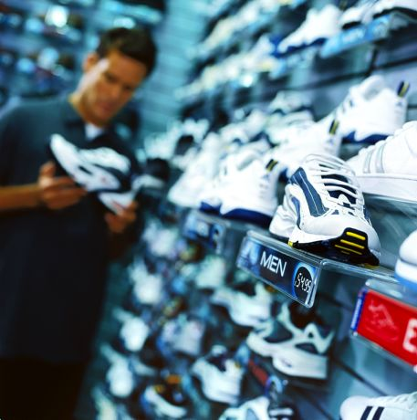
Three V’s Approach to Marketing
Define the value segment
Define the value proposition
Define the value network

Slide 5
What is the Value Chain?
The value chain is a tool for identifying ways to create more customer value because every firm is a synthesis of primary and support activities performed to design, produce, market, deliver, and support its product.

Slide 6
Core Business Processes
Market-sensing process
New-offering realization process
Customer acquisition process
Customer relationship management process
Fulfillment management process

Slide 7
Characteristics of Core Competencies
A source of competitive advantage
Applications in a wide variety of markets
Difficult to imitate

Slide 8
Firms Should Consider Key Questions
Can we learn from the past?
How should the present be evaluated?
What do we envision for the future?

Slide 9
What is Holistic Marketing?
Holistic marketing sees itself as integrating the value exploration, value creation, and value delivery activities with the purpose of building long-term, mutually satisfying relationships and coprosperity among key stakeholders.

Slide 10
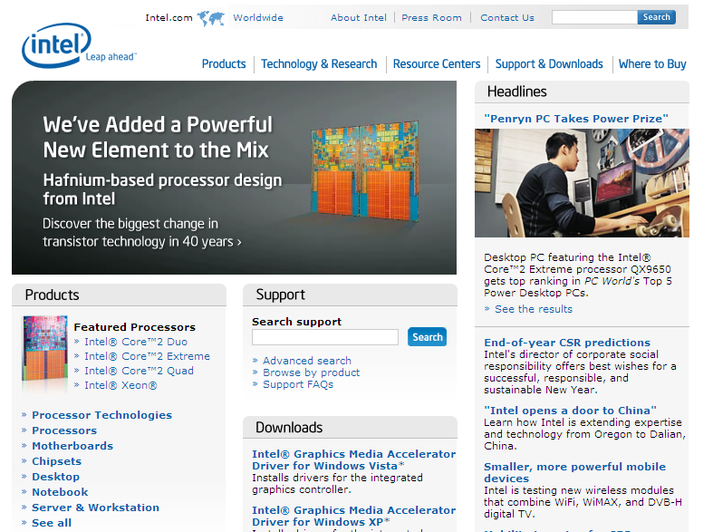
Intel’s New Brand Identity: Leap Ahead

Slide 11
What is a Marketing Plan?
A marketing plan is the central instrument for directing and coordinating the marketing effort.
It operates at a strategic and tactical level.

Slide 12
Levels of a Marketing Plan
Strategic
Target marketing decisions
Value proposition
Analysis of marketing opportunities
Tactical
Product features
Promotion
Merchandising
Pricing
Sales channels
Service

Slide 13
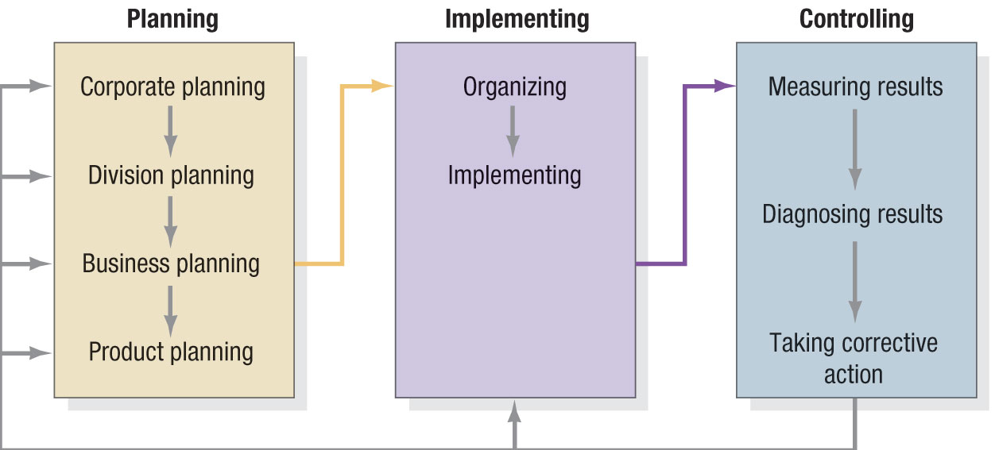
Figure 2.2 The Strategic Planning, Implementation, and Control Processes

Slide 14
Corporate Headquarters’ Planning Activities
Define the corporate mission
Establish strategic business units (SBUs)
Assign resources to each SBU
Assess growth opportunities

Slide 15

Good Mission Statements
Focus on limited number of goals
Stress major policies and values
Define major competitive spheres
Take a long-term view
Short, memorable, meaningful

Slide 16
Major Competitive Spheres
Industry
Geographical
Products
Vertical
channels
Competence
Market
segment

Slide 17
Rubbermaid Commercial Products, Inc.
“Our vision is to be the Global Market Share
Leader in each of the markets we serve. We
will earn this leadership position by
providing to our distributor and end-user
customers innovative, high-quality, cost-
effective and environmentally responsible
products. We will add value to these products
by providing legendary customer service
through our uncompromising Commitment
to Customer Satisfaction.”

Slide 18
Motorola
“The purpose of Motorola is to honorably
serve the needs of the community by providing
products and services of superior quality at a
fair price to our customers; to do this so as to
earn an adequate profit which is required for
the total enterprise to grow; and by doing so,
provide the opportunity for our employees and
shareholders to achieve their personal
objectives.”

Slide 19
eBay
“We help people trade anything on earth.
We will continue to enhance the online
trading experiences of all—collectors,
dealers, small businesses, unique item
seekers, bargain hunters, opportunity
sellers, and browsers.”

Slide 20
Table 2.3 Product Orientation vs. Market Orientation
Company | Product | Market
Missouri-Pacific Railroad | We run a railroad | We are a people-and-goods mover
Xerox | We make copying equipment | We improve office productivity
Standard Oil | We sell gasoline | We supply energy
Columbia Pictures | We make movies | We entertain people

Slide 21
Dimensions That Define a Business
Customer
groups
Customer
needs
Technology

Slide 22
Characteristics of SBUs
It is a single business or collection of related businesses
It has its own set of competitors
It has a leader responsible for strategic planning and profitability

Slide 23
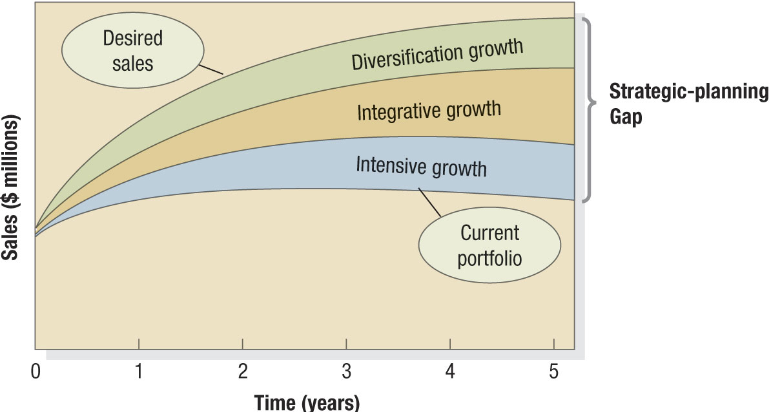
Figure 2.3 The Strategic Planning Gap

Slide 24
Strategies Suggested by Ansoff’s Product-Market Expansion Grid
Market penetration
Market development
Product development
Diversification

Slide 25
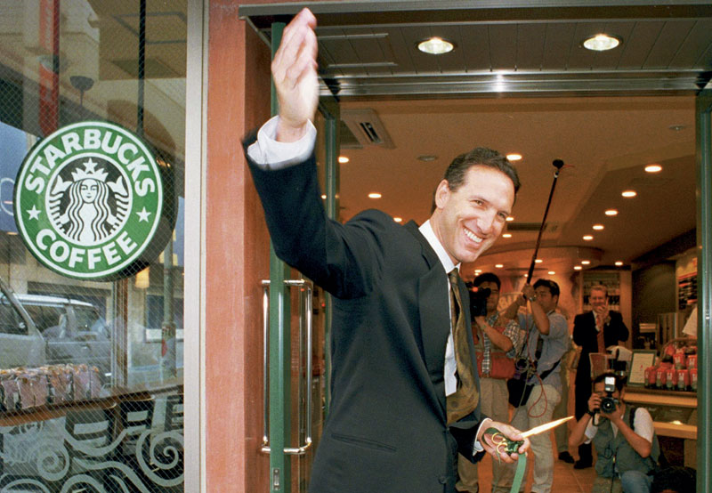
The Growth of Starbucks

Slide 26
What is Corporate Culture?
Corporate culture is the shared experiences, stories, beliefs, and norms that characterize an organization.

Slide 27
Tactics for Managing Change
Avoid the innovation title for the team
Use the buddy system
Set the metrics in advance
Aim for quick hits first
Get data to back up your gut

Slide 28
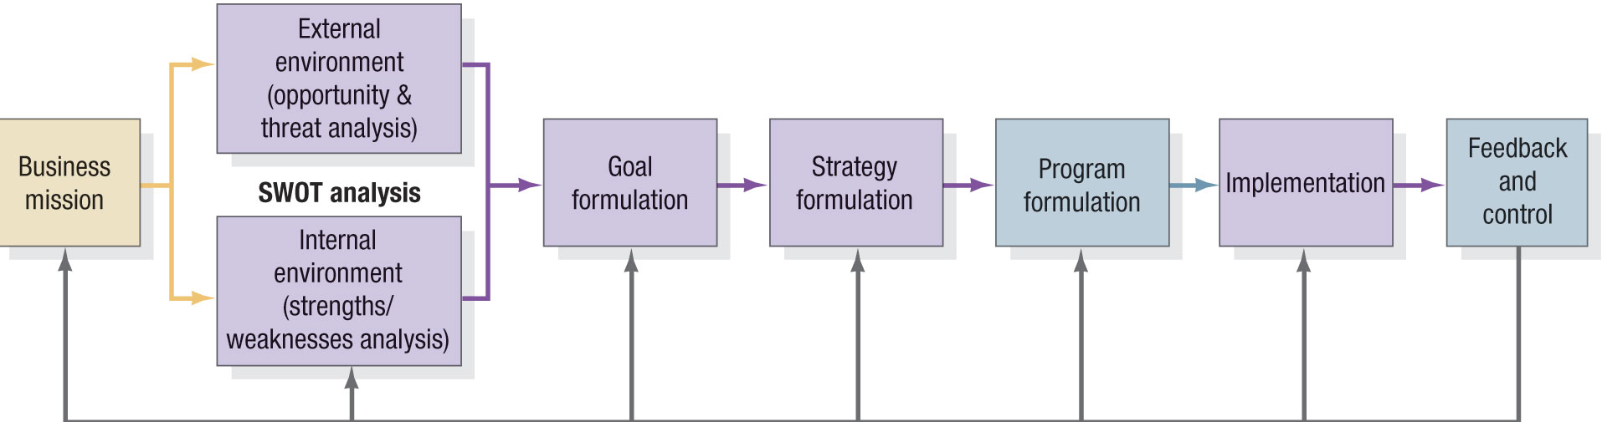
Figure 2.5 The Business Unit Strategic Planning Process

Slide 29

SWOT Analysis
Strengths
Weaknesses
Opportunities
Threats

Slide 30
Market Opportunity Analysis (MOA)
Can the benefits involved in the opportunity be articulated convincingly to a defined target market?
Can the target market be located and reached with cost-effective media and trade channels?
Does the company possess or have access to the critical capabilities and resources needed to deliver the customer benefits?

Slide 31
Market Opportunity Analysis (MOA) (cont.)
Can the company deliver the benefits better than any actual or potential competitors?
Will the financial rate of return meet or exceed the company’s required threshold for investment?

Slide 32
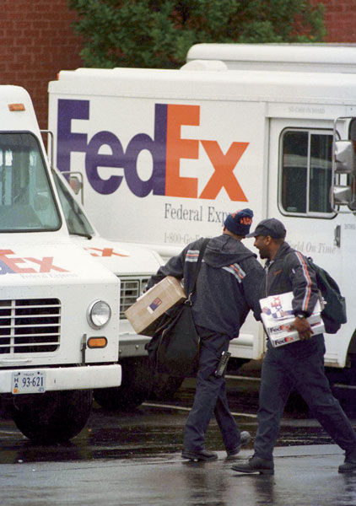
FedEx
FedEx added Sunday deliveries
based on customer requests and
market demand

Slide 33
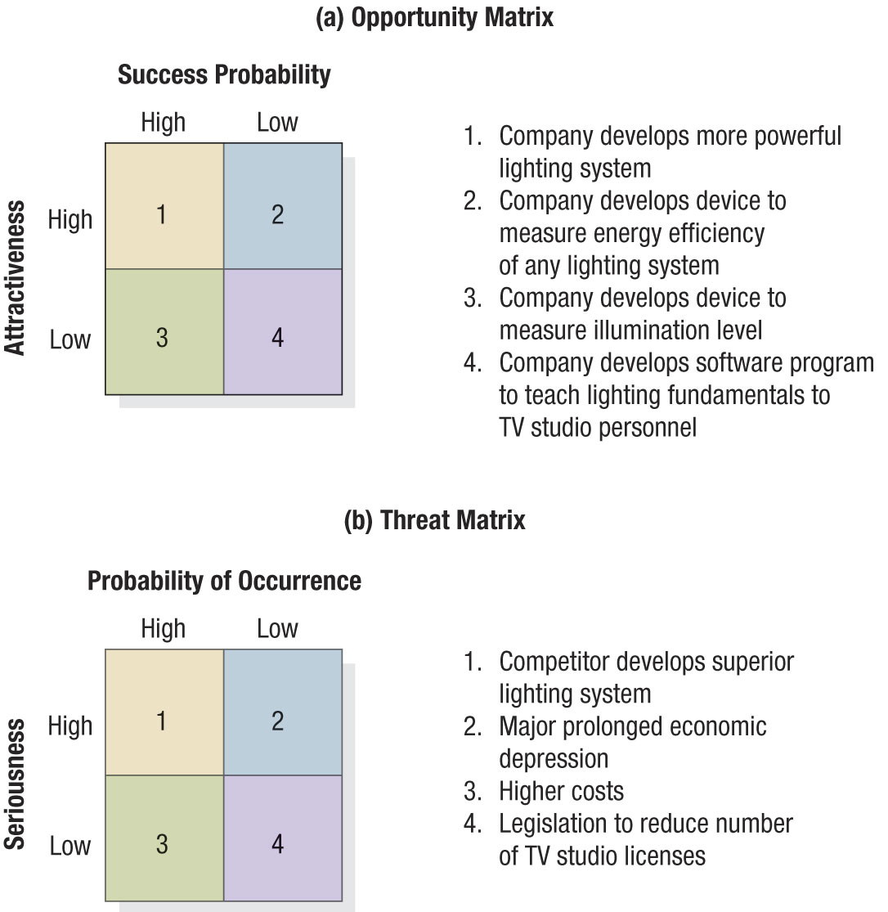
Figure 2.6 Opportunity Matrix

Slide 34
Figure 2.6 Threat Matrix

Slide 35
Goal Formulation and MBO
Unit’s objectives must be hierarchical
Objectives should be quantitative
Goals should be realistic
Objectives must be consistent

Slide 36

Porter’s Generic Strategies
Overall Cost Leadership
Differentiation
Focus

Slide 37
Categories of Marketing Alliances
Product or Service Alliances
Promotional Alliances
Logistics Alliances
Pricing Collaborations

Slide 38
Marketing Plan Contents
Executive summary
Table of contents
Situation analysis
Marketing strategy
Financial projections
Implementation controls

Slide 39
Evaluating a Marketing Plan
Is the plan simple?
Is the plan specific?
Is the plan realistic?
Is the plan complete?

Slide 40
Marketing Debate
What good is a mission statement?
Take a position:
Mission statements are critical to a
successful marketing organization.
or
2. Mission statements rarely provide
useful marketing value.

Slide 41
Marketing Discussion
What implications do Porter’s value
chain and the holistic marketing
orientation model have for
marketing planning?

